Slide 1

ONLINE QUIZ SYSTEM
SOA Project Review-1
BATCH - 5
Date& Time
 | Under the Guidance of Dr.NAVYATHA RANI, Department of Computer Science and Engineering, KLH CSE Bowrampet Campus
Team Members: 1.OM PANDEY 2420030791 2.SRUJAN 2420030082 3.DHANUSH 2420030788 4.MUNUDEEP 2420090018

Slide 2

Outline of Project Work
Focus
Introduction
Literature Survey
Challenges
Research Objectives
Conclusion & Future Work
References
Publications Details

Slide 3
Problem Statement
PROBLEM STATEMENT
Traditional quiz systems rely on manual question paper preparation, distribution, evaluation, and result generation, making the overall process time-consuming and prone to errors. Managing users, questions, quizzes, and results through separate manual processes is also difficult and inefficient. Therefore, there is a need for a centralized and automated online platform that can conduct quizzes, automatically evaluate student answers, and generate results quickly. To address these limitations, the proposed Online Quiz System uses a microservices-oriented architecture to improve scalability, maintainability, and reliability.

Slide 4
Objectives
OBJECTIVES
To develop a user-friendly web-based Online Quiz System** that enables secure student participation and allows administrators/instructors to manage quizzes, users, questions, and results.
*To provide an effective quiz platform** with multiple-choice questions, correct answers, marks, and time limits.
To automatically evaluate submitted answers** and quickly generate and display quiz scores and results.
To implement a microservices-oriented architecture** to improve the system’s scalability, flexibility, and maintainability.

Slide 5
Literature Survey
Authors | Title of the Paper | Methodology | Inferences | Limitation/Future work
Author 1 et al | Online Quiz / Assessment System | Web-based online assessment with automated evaluation | Reduces manual effort and provides faster evaluation | Can be improved with scalable architecture
Author 2 et al. | Automated Online Examination System | Online examination and automatic result generation | Improves evaluation speed and accuracy | Limited advanced management features
Author 3 et al. | Microservices-Based Web Application | Independent services communicating through REST APIs | Improves scalability and maintainability | Requires proper service communication and management

Slide 6
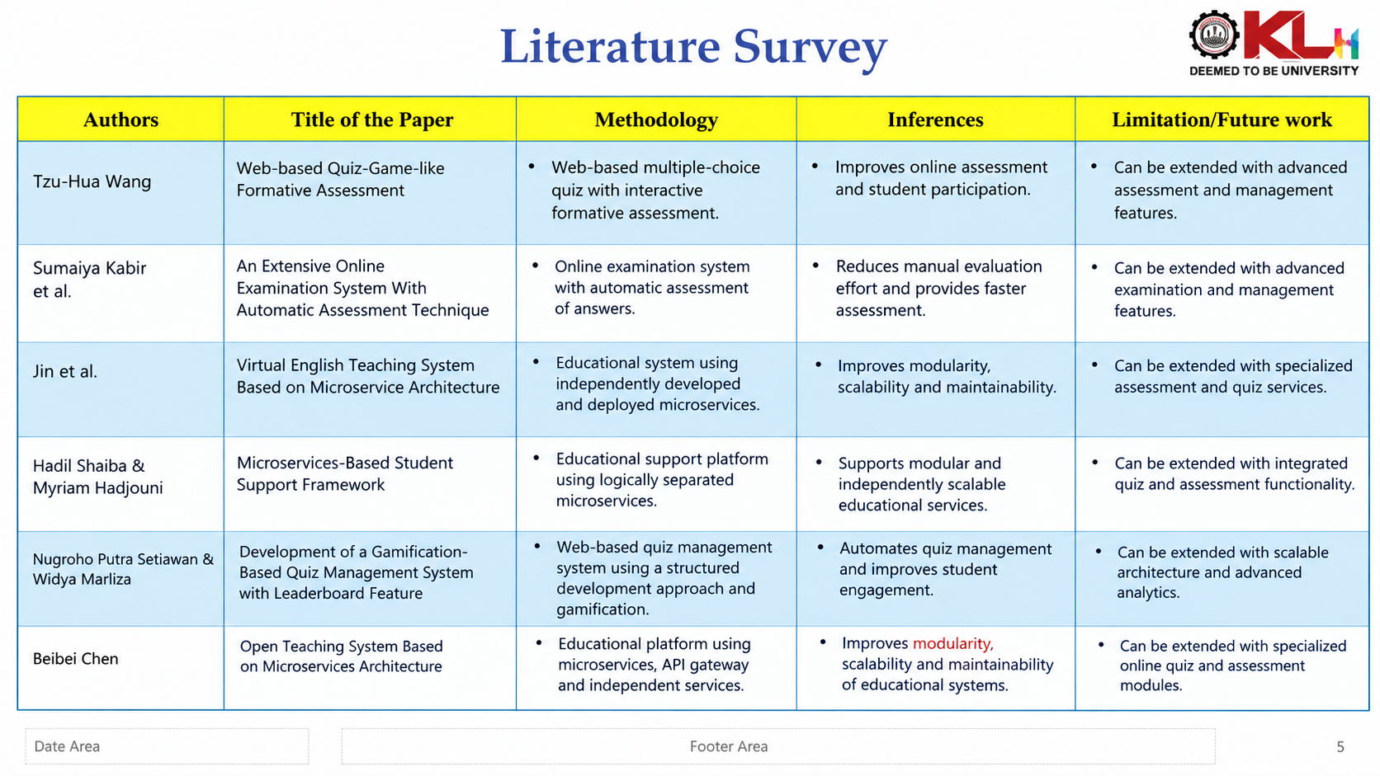

Slide 7
Problem Gap Identification
Existing Systems | Identified Gap | Proposed System
Manual quiz preparation and evaluation | Time-consuming process | Automated quiz management
Manual result calculation | Possibility of errors and delays | Automatic evaluation and result generation
Separate management of users, questions and results | Difficult to manage efficiently | Centralized management system
Tightly coupled application structure | Difficult to scale and maintain | Microservices-oriented architecture
Limited flexibility in system expansion | Difficult to add or modify functionalities | Independent services with REST API communication

Slide 8
Innovation, Creativity, and Novelty
🔹 Innovation
Automates the complete online quiz process from quiz creation to result generation.
Provides automatic evaluation of submitted answers.
Uses a microservices-oriented architecture to separate major system functionalities.
Enables communication between services through REST APIs.
🔹 Creativity
Provides an interactive and user-friendly platform for students and instructors.
Supports quiz features such as multiple-choice questions, marks and time limits.
Allows students to participate in quizzes conveniently through the web.
🔹 Novelty
Separates authentication, quiz, question, evaluation and result management into independent services.
Improves scalability, maintainability, flexibility and reliability compared with a tightly integrated system.
Provides a centralized database for users, quizzes, questions, answers and results.

Slide 9
Feasibility and Project Plan
1. Technical Feasibility
Web-based application can be developed using modern web technologies.
Microservices architecture separates major functionalities.
REST APIs enable communication between services.
Centralized database stores users, quizzes, questions, answers and results.
The proposed architecture supports scalability and maintainability.
2. Operational Feasibility
Students can access and attempt quizzes through the web.
Administrators and instructors can create and manage quizzes.
Automatic evaluation provides faster results.
The system can be accessed from any location with internet connectivity.

Slide 10
3. Project Plan
Phase | Major Activity
Phase 1 | Requirement Analysis
Phase 2 | System & Architecture Design
Phase 3 | Database Design
Phase 4 | Microservices Development
Phase 5 | Frontend Development
Phase 6 | Integration & API Testing
Phase 7 | System Testing
Phase 8 | Deployment & Documentation

Slide 11
Timeline Chart:-
Project Phase | W1 | W2 | W3 | W4 | W5 | W6
1. Requirements & Analysis | ● | ●
2. System & Database Design |  | ● | ●
3. Backend / Microservices |  |  | ● | ●
4. Frontend Development |  |  |  | ● | ●
5. Integration & Testing |  |  |  |  | ● | ●
6. Documentation & Deployment |  |  |  |  |  | ●

